Slide 1

Apex Institute of Technology
Department of Computer Science & Engineering
Bachelor of Engineering (Computer Science & Engineering)
Design and Analysis of Algorithms– (20CSH-282)
Prepared By: Mr. Vikas Kumar (E13657)
DISCOVER . LEARN . EMPOWER

Slide 2
Basic Matrix Multiplication
void matrix_mult (){
for (i = 1; i <= N; i++) {
for (j = 1; j <= N; j++) { compute C_{i,j}; }
}}
------------→Algorithm
Time analysis--------------------→

Slide 3
Strassens’s Matrix Multiplication
Strassen showed that 2x2 matrix multiplication can be accomplished in 7 multiplication and 18 additions or subtractions. .(2^{log}₂⁷ =2^{2.807})
This reduction can be done by Divide and Conquer Approach.

Slide 4
Divide-and-conquer
Divide-and-conquer is a general algorithm design paradigm:
Divide: divide the input data S into two or more disjoint subsets S₁, S₂, …
Recur: solve the subproblems recursively
Conquer: combine the solutions for S₁, S₂, …, into a solution for S
The base case for the recursion is subproblems of constant size
Analysis can be done using recurrence equations

Slide 5
Divide and Conquer Matrix Multiply
A × B = R
A₀ | A₁
A₂ | A₃
B₀ | B₁
B₂ | B₃
A₀×B₀+A₁×B₂ | A₀×B₁+A₁×B₃
A₂×B₀+A₃×B₂ | A₂×B₁+A₃×B₃
×
=
Divide matrices into sub-matrices: A₀ , A₁, A₂ etc
Use blocked matrix multiply equations
Recursively multiply sub-matrices

Slide 6
Divide and Conquer Matrix Multiply
A × B = R
a₀
b₀
a₀ × b₀
×
=
Terminate recursion with a simple base case

Slide 7

Strassen’s Matrix Multiplication
P₁ = (A₁₁+ A₂₂)(B₁₁+B₂₂) P₂ = (A₂₁ + A₂₂) * B₁₁ P₃ = A₁₁ * (B₁₂ - B₂₂) P₄ = A₂₂ * (B₂₁ - B₁₁) P₅ = (A₁₁ + A₁₂) * B₂₂ P₆ = (A₂₁ - A₁₁) * (B₁₁ + B₁₂) P₇ = (A₁₂ - A₂₂) * (B₂₁ + B₂₂)
C₁₁ = P₁ + P₄ - P₅ + P₇ C₁₂ = P₃ + P₅ C₂₁ = P₂ + P₄ C₂₂ = P₁ + P₃ - P₂ + P₆

Slide 8
Strassen’s Matrix Multiplication
Example:
3 5 x 2 7
4 6 8 3
a00=3, a01= 5, a10=4, a11=6, b00=2, b01=7, b10=8, b11=3
m1 = (a00 + a11) x (b00 + b11)
=(3+6) x (2+3) =9 x 5 = 45
m2 = (a10 + a11) x b00
=(4+6) x 2
=10 x 2 =20
m3 = a00 x (b01 – b11)
=3 x (7-3) = 3 x 4 =12

Slide 9
Strassen’s Matrix Multiplication
m4 = a11 x (b10 – b00)
=6 x (8-2) = 6 x 6 =36
m5 = (a00 + a01) x b11
= (3+5) x 3 =24
m6 = (a10 – a00) x (b00 + b01)
=(4-3) x (2+7) =9
m7 = (a01 – a11) x (b10 + b11)
= (5-6) x (8+3)
=(-1) x 11 = -11

Slide 10
Strassen’s Matrix Multiplication
m1+m4 - m5+m7 = 45+36-24+(-11) =81-35 =46
m3+m5=12+24 =36
m2+m4=20+36=56
m1+m3-m2+m6=45+12-20+9 =66-20 =46
[𝐶00 𝐶01]= [𝑚1+𝑚4−𝑚5+𝑚7 𝑚3+𝑚5
𝐶10 𝐶11 𝑚2+𝑚4 𝑚1+𝑚3−𝑚2+𝑚6]
C=[46 36]
56 46

Slide 11
Strassen Algorithm
void matmul(int *A, int *B, int *R, int n) {
if (n == 1) {
(*R) += (*A) * (*B);
} else {
matmul(A, B, R, n/4);
matmul(A, B+(n/4), R+(n/4), n/4);
matmul(A+2*(n/4), B, R+2*(n/4), n/4);
matmul(A+2*(n/4), B+(n/4), R+3*(n/4), n/4);
matmul(A+(n/4), B+2*(n/4), R, n/4);
matmul(A+(n/4), B+3*(n/4), R+(n/4), n/4);
matmul(A+3*(n/4), B+2*(n/4), R+2*(n/4), n/4);
matmul(A+3*(n/4), B+3*(n/4), R+3*(n/4), n/4);
}
Divide matrices into sub-matrices and recursively multiply sub-matrices

Slide 12
Recurrence equation for Strassen’s approach
T(n) = 7.T(n/2)
Two matrices of size 1 x 1 need only one multiplication, so the base case would be, T (1) = 1.
Let us find the solution using the iterative approach.
By substituting n = (n / 2) ,
T(n) = 7.T(n/2)
T(n/2) = 7.T(n/4)
⇒ T(n) = 72.T(n/2²)

Slide 13
Recurrence equation for Strassen’s approach
T(n) = 7k.T(2^{k})
Let’s assume n = 2^{k} ⇒ k = log2 n
T (n) = 7^{k} .T(2^{k} / 2^{k})
= 7^{k} .T (1)
= 7^{k}
= 7log2 n
= nlog2 7
= n^{2.81} < n3

Slide 14
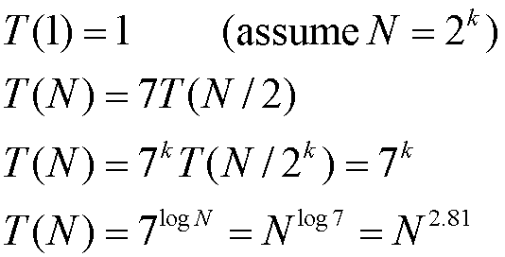
Time Complexity Analysis

Slide 15
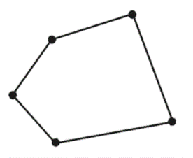
CONVEX HULL
Convex hull is the smallest region covering a given set of points.
Polygon is called a convex polygon if the angle between any of its two adjacent edges is always less than 180⁰.
Otherwise, it is called a concave polygon.
Complex polygons are self-intersecting polygons.

Slide 16
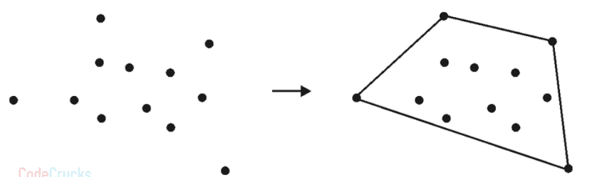
CONVEX HULL
set of points Q is the convex polygon P that encompasses all of the points given.
The problem of finding the smallest polygon P such that all the points of set Q are either on the boundary of P or inside P is known as the convex hull problem.
The vertex of a polygon is a point shared by two neighboring edges.

Slide 17
CONVEX HULL: Divide and Conquer Approach
Sort all of the points by their X coordinates. The tie is broken by ranking points according to their Y coordinate.
Determine two extreme points A and B, where A represents the leftmost point and B represents the rightmost point. A and B would be the convex hull’s vertices. Lines AB and BA should be added to the solution set.
Find point C which is the farthest away from line AB.
Calculate the convex hull of the points on the line AC’s right and left sides. Remove line AB from the original solution set and replace it with AC and CB.
Process the points on the right side of line BA in the same way.
Find the convex hull of the points on the left and right of the line connecting the two farthest points of that specific convex hull recursively.

Slide 18
CONVEX HULL: Algorithm
Algorithm FindHull(P, A, B)
if isEmpty(P) then
return
else
C ← Orthogonally farthest point from AB
Solution ← Replace AB by AC followed by CB
Partition P – { C } in X0, X1 and X2
Discard X0 in side triangle
Call FindHull(X1, A, C)
Call FindHull(X2, C, B)
end
Algorithm ConvexHull(P)
// P is a set of input points
Sort all the points in P and find two extreme points A and B
S1 ← Set of points right to the line AB
S2 ← Set of points right to the line BA
Solution ← AB followed by BA
Call FindHull(S1, A, B)
Call FindHull(S2, B, A)

Slide 19
CONVEX HULL: Analysis
Pre-processing step is to sort the points according to the increasing order of their X coordinate.
Sorting : O(nlog2n).
Finding the two farthest points from the sorted list: O(1).
Dividing points into two halves S1 and S2 : O(1) by joining A and B.

Slide 20
CONVEX HULL: Recurrence
T(n) = 2T(n/2) + O(n) + O(1)
= 2T(n/2) + n … (1)
Solving original recurrence for n/2,
T(n/2) = 2T(n/4) + n/2
Substituting this in equation (1),
T(n) = 2[ 2T(n/4) + n/2 ] + n
= 2² T(n/2²) + 2n
.
.
.

Slide 21
CONVEX HULL: Recurrence
After k substitutions,
T(n) = 2^{k} T(n/2^{k}) + k.n … (2)
Division of array creates a binary tree, which has height log2n, so let us consider that k grows up to log2n,
k = log2n ⇒ n = 2^{k}
Substitute these values in equation (2)
T(n) = n.T(n/n) + log2n . n
T(n) = O(n.log2n)

Slide 22
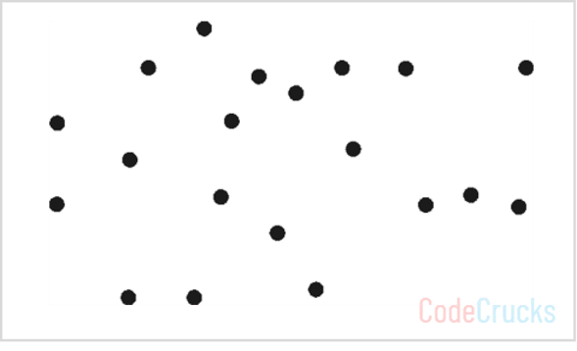
CONVEX HULL: Example
Find the convex hull for a given set of points using the divide and conquer approach.

Slide 23
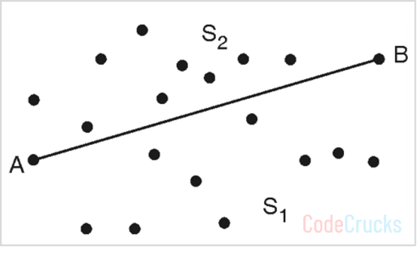
CONVEX HULL: Example
Step 1: According to the algorithm, find left most and rightmost points from the set P and label them as A and B. Label all the points on the right of AB as S1 and all the points on the right of BA as S2.
Solution = {AB, BA}
Make a recursive call to FindHull (S1, A, B) and FindHull(S2 ,B, A)

Slide 24
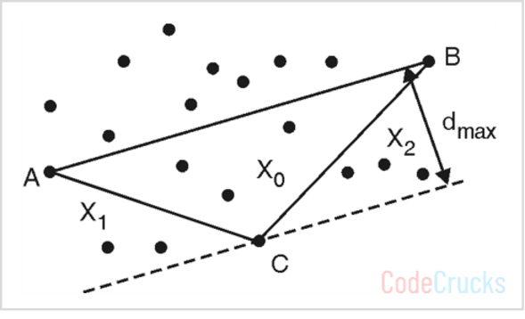
CONVEX HULL: Example
Step 2 : FindHull(S1 ,A, B)
Find point C orthogonally farthest from line AB
Solution = Solution – { AB } ∪ {AC, CB}
= {AC, CB, BA}
Label regions X0, X1 and X2 as shown in above figure
Make recursive calls: FindHull (X1, A, C) and FindHull (X2, C, B)

Slide 25
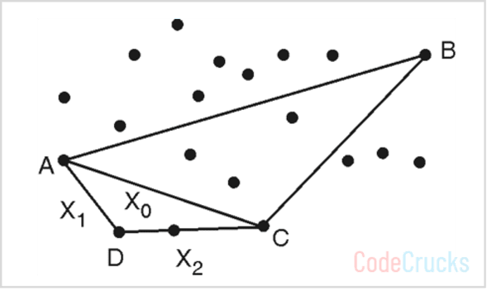
CONVEX HULL: Example
Step 3 : FindHull(X1, A, C)
Find point D orthogonally farthest from line AC
Solution = Solution – {AC} ∪ {AD, DC}
= {AD, DC, CB, BA}
Label regions X0, X1 and X2 as shown in above figure
Make recursive calls: FindHull (X1, A, D) and FindHull (X2, D, C)
But X1 and X2 sets are empty, so the algorithm returns

Slide 26
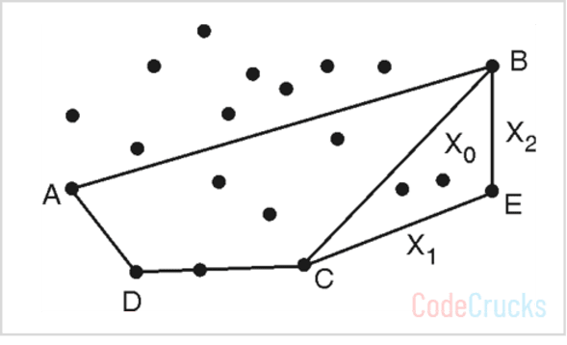
CONVEX HULL: Example
Step 4 : FindHull(X2, C, B)
Find point E orthogonally farthest from line CB
Solution = Solution – {CB} ∪ {CE, EB}
= {AD, DC, CE, EB, BA}
Label regions X0, X1, and X2 as shown in Fig.
Make recursive calls: FindHull (X1, C, E) and FindHull (X2, E, B).
But X1 and X2 sets are empty, so the algorithm returns Now we will explore the points in S2, on the right-hand side of the line BA

Slide 27
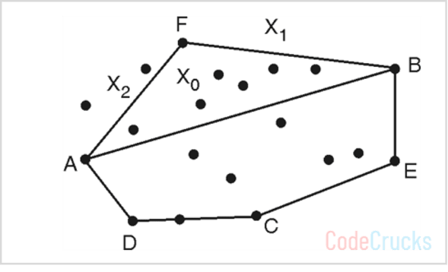
CONVEX HULL: Example
Step 5 : FindHull(S2 ,B, A)
Find point F orthogonally farthest from line BA
Solution = Solution – {BA} ∪ {BF, FA}
= {AD, DC, CE, EB, BF, FA}
Label regions X0, X1 and X2 as shown in above figure.
Make recursive calls : FindHull (X1, B, F) and FindHull (X2, F, A)
But X1 set is empty, so call to FindHull (X1, B, F) returns

Slide 28
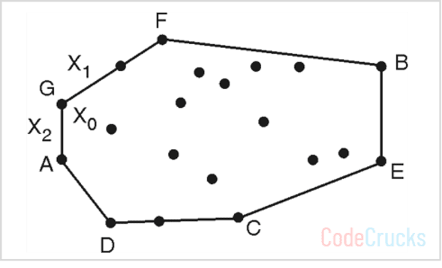
CONVEX HULL: Example
Step 6 : FindHull (X2, F, A)
Find point G orthogonally farthest from line FA
Solution = Solution – {FA} ∪ {FG, GA}
= {AD, DC, CE, EB, BF, FG, GA}
Make recursive calls: FindHull (X1, F, G) and FindHull (X2, G, A).
But X1 and X2 sets are empty, so the algorithm returns.
And no more recursive calls are left.
So polygon with edges (AD, DC, CE, EB, BF, FG, GA) is the convex hull of given points.

Slide 29
CONVEX HULL: Applications
Collision avoidance
Smallest Box
Shape Analysis

Slide 30
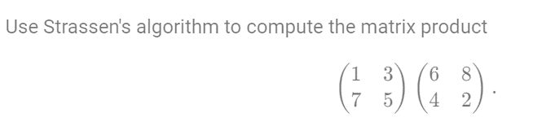
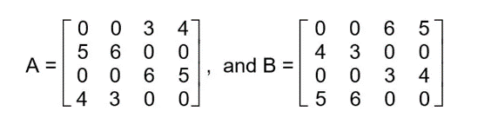
TASKS END OF LECTURE LEARNING (TELL):
TASK 1:
TASK 2:
Multiply given two matrices A and B using Strassen’s approach, where

Slide 31
References
Fundamentals of Computer Algorithms 2nd Edition (2008) by Horowitz, Sahni and Rajasekaran
Introduction to Algorithms 3rd Edition (2012) by Thomas H Cormen, Charles E Lieserson, Ronald

Slide 32
THANK YOU
For queries
Email: vikash.e13657@cumail.in

